Slide 1
https://www.youtube.com/watch?v=xB5ceAruYrI&list=PLc03_vAS-5G4eSPaeJsTnFXUyxKLMHNso&index=8&t=0s

Slide 2
What are the zones?
A concept used to help you self regulate your feelings
The Zones of Regulation helps you to categorise how your body feels and explain your emotions. The four coloured zones help you to do this.
The Zones framework provides you strategies to become more aware and independent in controlling your emotions and impulses.
It also improves your ability to problem solve conflicts and helps you to stay in the right zones in school.

Slide 3
What do the ZONES of Regulation® do?
The ZONES are designed to help YOU self regulate by recognising when you are in different zones and how to use strategies to change or stay in the zone you are in.
Self-regulation can go by many names, such as self-control, self-management and impulse control. It is defined as the best state of alertness of both the body and emotions for the specific situation.
For example, when you play on the playground, it is beneficial to have a higher state of alertness, however, that same state would not be appropriate in say the classroom learning. So ,it is important you all become aware of your different zones and when it is appropriate to be in that zone.

Slide 4
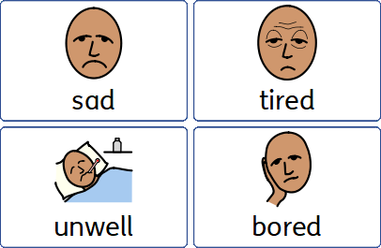
Blue Zone
Your body is running slow

Slide 5
Green Zone

Slide 6
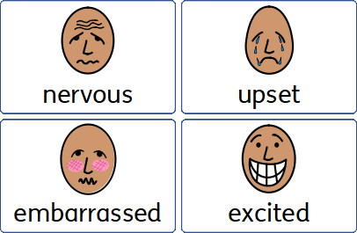
Yellow Zone

Slide 7
Red Zone

Slide 8
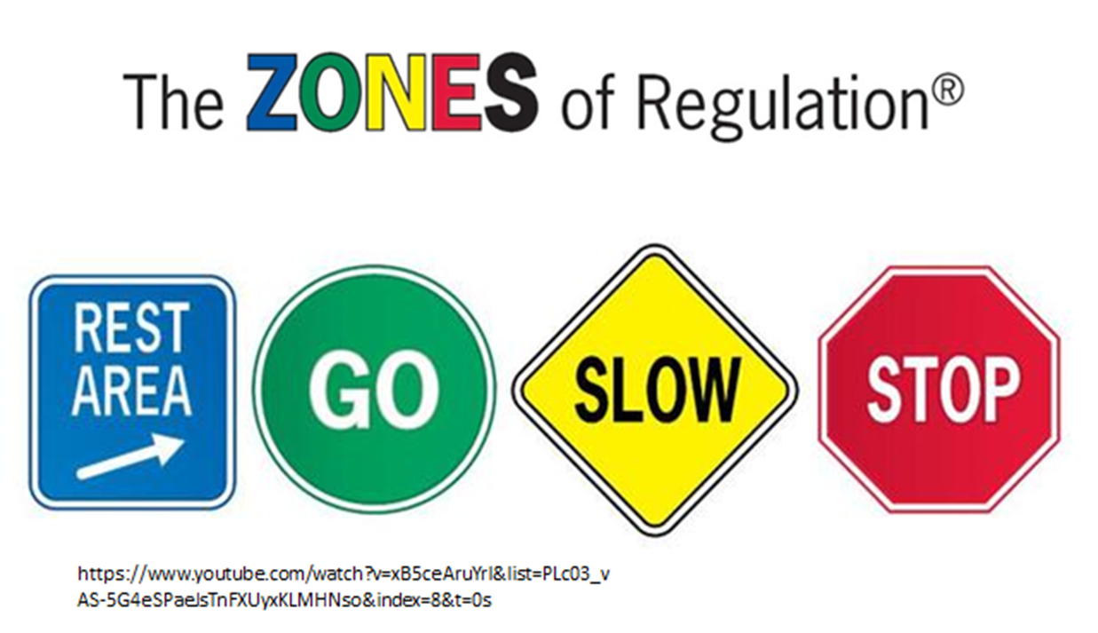
Let’s explain it to the kids…
https://www.bing.com/videos/search?q=zone+of+reg+youtibe&&view=detail&mid=6FFBC229715F25F446D96FFBC229715F25F446D9&&FORM=VDRVRV

Slide 9
How can we make the ZONES useful to us?
We can all learn the Zones properly by doing the following:
Use our colour language to tell others how we are feeling. Talk about the ZONES as we can apply them in a variety of environments.
Make it part of our everyday dialogue with each other-Teachers & Parents too! The more we hear about the ZONES, the more chance we will use them to help us self regulate our emotions!
Talk about our emotions, so we all understand it is natural to experience different zones and talk to others about the strategies you use to regulate your emotions. For example I might say if I can’t do something , “This is really stressing me out, I am feeling Yellow. I need to take some deep breaths and calm down.”

Slide 10
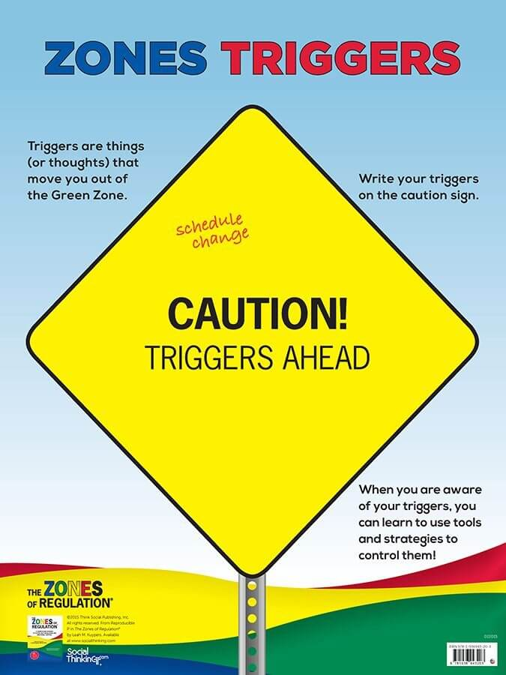
What triggers the zones?
An Emotional Trigger is a response to a person, situation, event, dialogue, reading, film etc, that provokes a strong emotional reaction in you.
Often you are not self aware when you are triggered and fall into reacting quickly, so the zones help you to think about any triggers that get a strong emotional response from you.

Slide 11
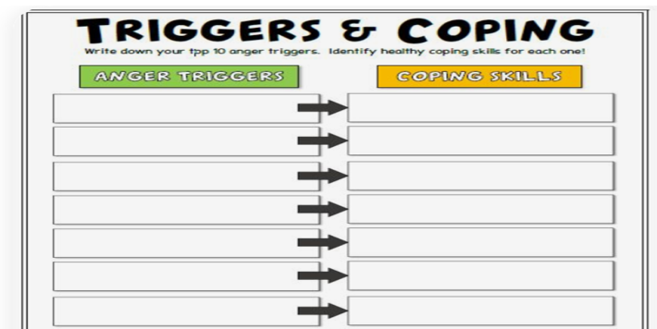
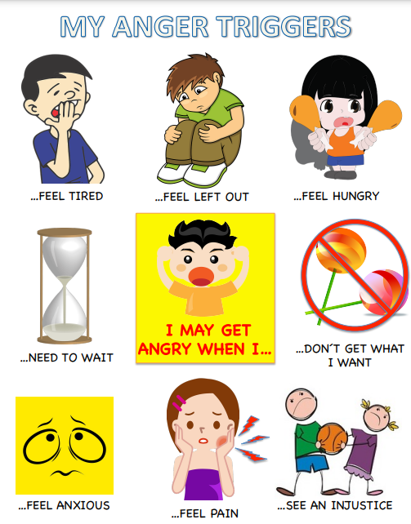
What can trigger how we feel and what zone we are in?
We can start to think about what could put us in a zone- A trigger or a stressor can be something that makes us feel an emotion that we might necessary not want to feel.
For example: a trigger for me feeling yellow is when I am tired- I feel like I can’t cope, I lose my patience and get snappy and grumpy! So for me, a coping strategy is a nice, hot bath and a goodnights sleep(that makes me green again!). It’s a simple one I know but it works!
What are your triggers/stressors and can cause you to end up in a zone?

Slide 12
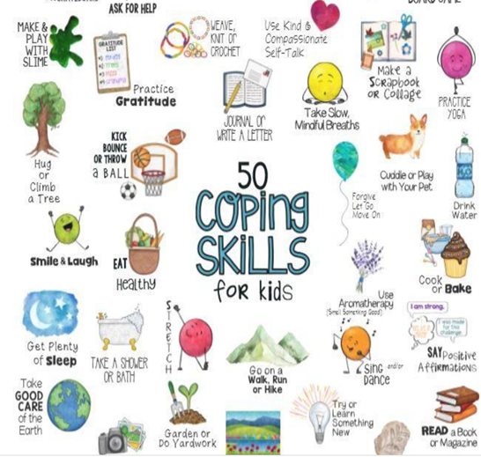
And remember….. there is no such thing as a bad ZONE!
It is important to note that everyone experiences all of the zones—the Red and Yellow Zones are not the “bad” or “naughty” zones.
We must all try and think about what could make us when we end up in a zone.
We must all start to think about what coping skills/strategies we have to get us back into the Green zone!
Most importantly, support others when they are feeling Yellow/Red as you might not realize it, but you could be one of their coping skills!

Slide 13
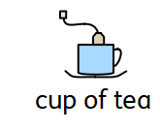
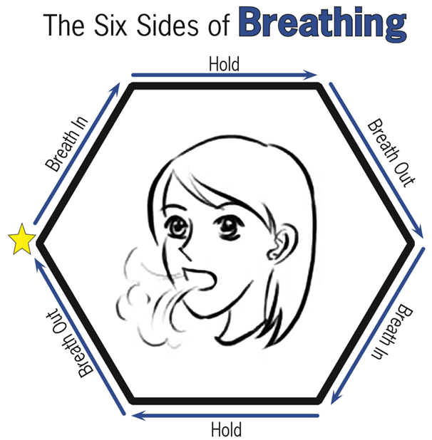
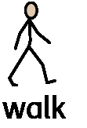
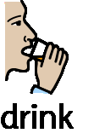

Slide 14
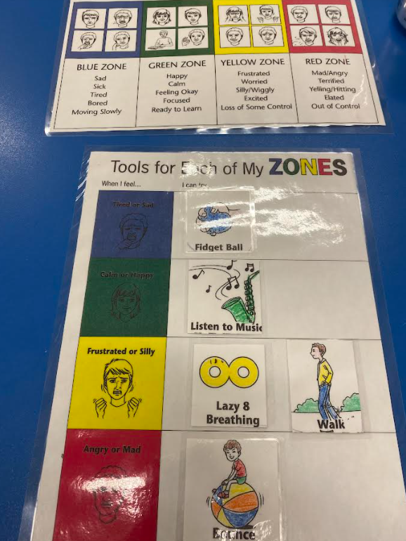
Classroom Self Regulation Tools and ZONES Visuals
Notes:
Visuals for Kids
*** Kindergarten student – Red Zone

Slide 15
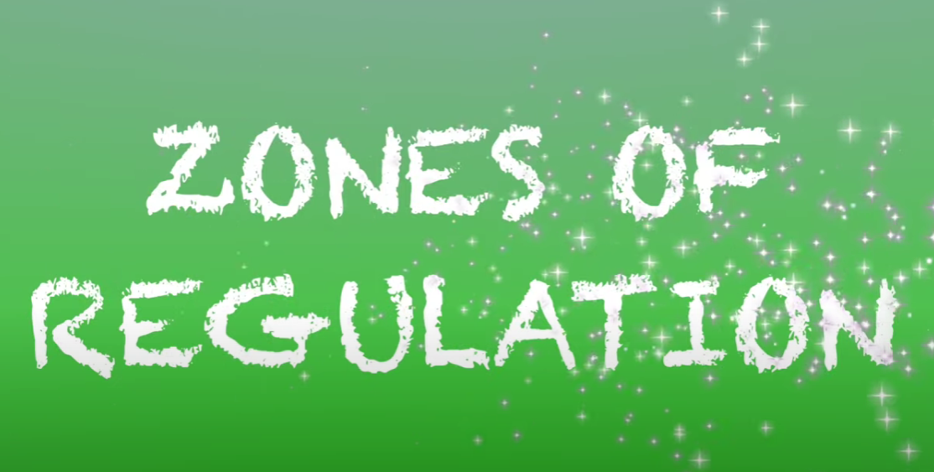
Cheesy tune….. Of course!
https://www.youtube.com/watch?v=wIRVklZXicM

